Slide 1
Chapter 9. Advanced Classes
CLASSIFIERS:-
A classifier is a mechanism that describes structural and behavioral features.
Classifiers include classes, interfaces, datatypes, signals, components, nodes, use cases, and subsystems.

Slide 2
The most important kind of classifier in the UML is the class.
Classes are not the only kind of classifier, however. The UML provides a number of other kinds of classifiers to help you model.
Interface :A collection of operations that are used to specify a service of a class or a component.
2. Datatype: A type whose values have no identity, including primitive built-in types (such as numbers and strings), as well as enumeration types (such as Boolean).

Slide 3
3. Signal: The specification of an asynchronous stimulus communicated between instances.
4. Component: A physical and replaceable part of a system that conforms to and provides the realization of a set of interfaces.
5. Node: A physical element that exists at run time and that represents a computational resource, generally having at least some memory and often processing capability.

Slide 4
6. Use case: A description of a set of a sequence of actions, including variants, that a system performs that yields an observable result of value to a particular actor.
7. Subsystem: A grouping of elements of which some constitute a specification of the behavior offered by the other contained elements.

Slide 5
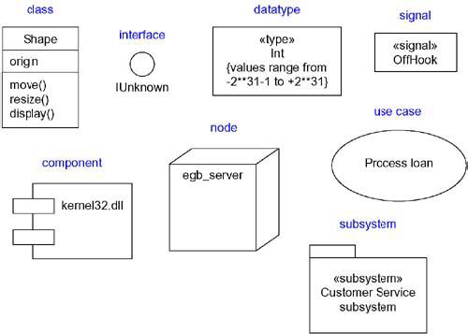
Graphically, the UML distinguishes among these different classifiers, as

Slide 6
Visibility:-
One of the most important details you can specify for a classifier's attributes and operations is its visibility.
The visibility of a feature specifies whether it can be used by other classifiers.
In the UML, you can specify any of three levels of visibility.

Slide 7
Public: Any outside classifier with visibility to the given classifier can use the feature; specified by prepending the symbol +
2. Protected: Any descendant of the classifier can use the feature; specified by prepending the symbol #
3. Private: Only the classifier itself can use the feature; specified by prepending the symbol -

Slide 8
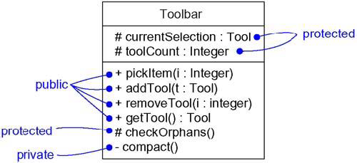
Visibility

Slide 9
Scope:-
Another important detail you can specify for a classifier's attributes and operations is its owner scope.
The owner scope of a feature specifies whether the feature appears in each instance of the classifier.

Slide 10
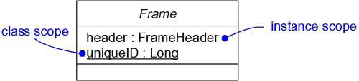
In the UML, you can specify two kinds of owner scope.
Instance: Each instance of the classifier holds its own value for the feature.
2. Classifier: There is just one value of the feature for all instances of the classifier.
Owner Scope

Slide 11
Abstract, Root, Leaf, and Polymorphic Elements
Use generalization relationships to model classes, with more-generalized abstractions at the top of the hierarchy and more-specific ones at the bottom.

Slide 12
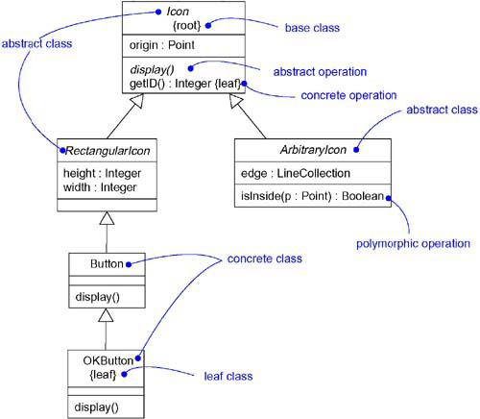
Abstract and Concrete Classes and Operations

Slide 13
A class may have no children. Such an element is called a leaf class and is specified in the UML by writing the property leaf below the class's name.
For example, in the figure, OKButton is a leaf class, so it may have no children.
Less common but still useful is the ability to specify that a class may have no parents. Such an element is called a root class, and is specified in the UML by writing the property root below the class's name.
For example, in the figure, Icon is a root class.

Slide 14
An operation is polymorphic, which means that, in a hierarchy of classes, you can specify operations with the same signature at different points in the hierarchy.
Ones in the child classes override the behavior of ones in the parent classes. When a message is dispatched at run time, the operation in the hierarchy that is invoked is chosen polymorphically - that is, a match is determined at run time according to the type of the object.
For example, display and isInside are both polymorphic operations.

Slide 15
The operation Icon::display() is abstract, meaning that it is incomplete and requires a child to supply an implementation of the operation.

Slide 16
Multiplicity:-
The number of instances a class may have is called its multiplicity.
Multiplicity is a specification of the range of allowable cardinalities an entity may assume.
In the UML, you can specify the multiplicity of a class by writing a multiplicity expression in the upper-right corner of the class icon.

Slide 17
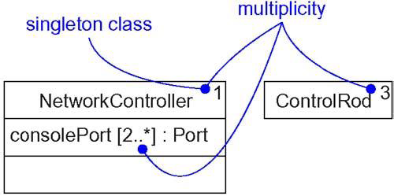
For example, in NetworkController is a singleton class. Similarly, there are exactly three instances of the class ControlRod in the system.

Slide 18
Multiplicity applies to attributes, as well. You can specify the multiplicity of an attribute by writing a suitable expression in brackets just after the attribute name.
For example, in the figure, there are two or more consolePort instances in the instance of NetworkController.

Slide 19
Attributes:-
At the most abstract level, when you model a class's structural features (that is, its attributes), you simply write each attribute's name.
The syntax of an attribute in the UML is
[visibility] name [multiplicity] [: type][= initial-value] [{property-string}]

Slide 20
For example, the following are all legal attribute declarations:
origin | Name only
+ origin | Visibility and name
origin : Point | Name and type
head : *Item | Name and complex type
name [0..1] : String | Name, multiplicity, and type
origin : Point = (0,0) | Name, type, and initial value
id : Integer {frozen} | Name and property

Slide 21
There are three defined properties that you can use with attributes.
changeable | There are no restrictions on modifying the attribute's value.
addOnly | For attributes with a multiplicity greater than one, additional values may be added, but once created, a value may not be removed or altered.
frozen | The attribute's value may not be changed after the object is initialized.
Unless otherwise specified, attributes are always changeable. You'll mainly want to use frozen when modeling constant or write-once attributes.

Slide 22
Operations:-
At the most abstract level, when you model a class's behavioral features (that is, its operations and its signals), you will simply write each operation's name.
You can also specify the parameters, return type, concurrency semantics, and other properties of each operation.
Collectively, the name of an operation plus its parameters (including its return type, if any) is called the operation's signature.

Slide 23
The UML distinguishes between operation and method.
An operation specifies a service that can be requested from any object of the class to affect behavior;
A method is an implementation of an operation.

Slide 24
The syntax of an operation in the UML is
[visibility] name [(parameter-list)][: return-type] [{property-string}]
For example, the following are all legal operation declarations:
display | Name only
+ display | Visibility and name
set(n : Name, s : String) | Name and parameters
getID() : Integer | Name and return type
restart() {guarded} | Name and property

Slide 25
In an operation's signature, you may provide zero or more parameters, each of which follows the
syntax
[direction] name : type [= default-value]
Direction may be any of the following values:
in -- An input parameter; may not be modified
out -- An output parameter; may be modified to
communicate information to the caller
inout-- An input parameter; may be modified.

Slide 26
In addition to the leaf property described earlier, there are four defined properties that you can use with operations.
isQuery : Execution of the operation leaves the state of the system unchanged. In other words, the operation is a pure function that has no side effects.
EX :- total()
2. Sequential: Callers must coordinate outside the object so that only one flow is in the object at a time.
  Withdraw ()

Slide 27
guarded: The semantics and integrity of the object is guaranteed in the presence of multiple flows of control by sequentializing all calls to all of the object's guarded operations.
In effect, exactly one operation at a time can be invoked on the object, reducing this to sequential semantics.
4. concurrent: The semantics and integrity of the object is guaranteed in the presence of multiple flows of control.

Slide 28
Standard Elements:-
The UML defines four standard stereotypes that apply to classes.
1. metaclass- Specifies a classifier whose objects are all classes.
2. powertype- Specifies a classifier whose objects are the children of a given parent.
3.stereotype -Specifies that the classifier is a stereotype that may be applied to other elements.
4. utility - Specifies a class whose attributes and operations are all class scoped.

